Slide 1
InstantSVC
The PHP Web Service Builder
Introduction and Motivation

Slide 2
Web Services?

Slide 3
Agenda
Web Services?
Brief Introduction to Web Service Technologies
Web Services with PHP5
The Vision
Notes:
Die Gliederung noch überarbeiten
Einzelteile vielleicht unter Web Service Toolkit für PHP5 zusammenfassen

Slide 4
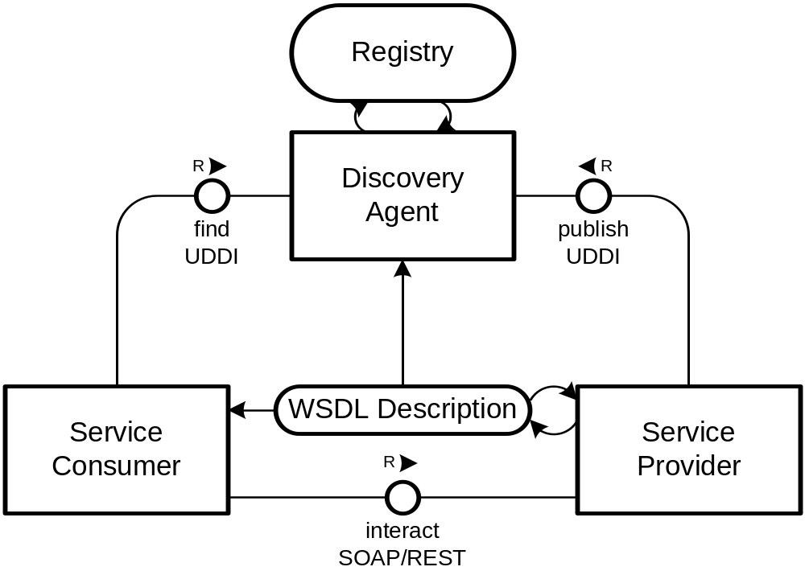
Web Services
  Functions of an application
  exposed as services
  Technologies:
    HTTP
    SOAP
    WSDL
    UDDI
  Alternative:
    REST
  Powerful concept for cross-platform integration
Notes:
B2B Integration
Buzzword: SOA
Client Anbindung
Bsp.: EBay, Amazon E-Commerce
Google Suche
Aber auch zur Bereitstellung von z.B. Content, Premium Content an Partner
Hier Einsatzgebiet Lehrveranstaltungen/Vorlesungen/Konferenzvorträge mit z.B. Videoaufzeichnungen
Nutzung durch Partner für Lehrveranstaltungen z.B. in China
Beschreibung über Web Service Description Language

Slide 5
The Core Web Services Protocol Stack
Discovery | UDDI
Description | WSDL
Access | SOAP, SOAP with Attachments, (REST)
Transfer | HTTP, SMTP, FTP, others
Transport | TCP, UDP, others

Slide 6
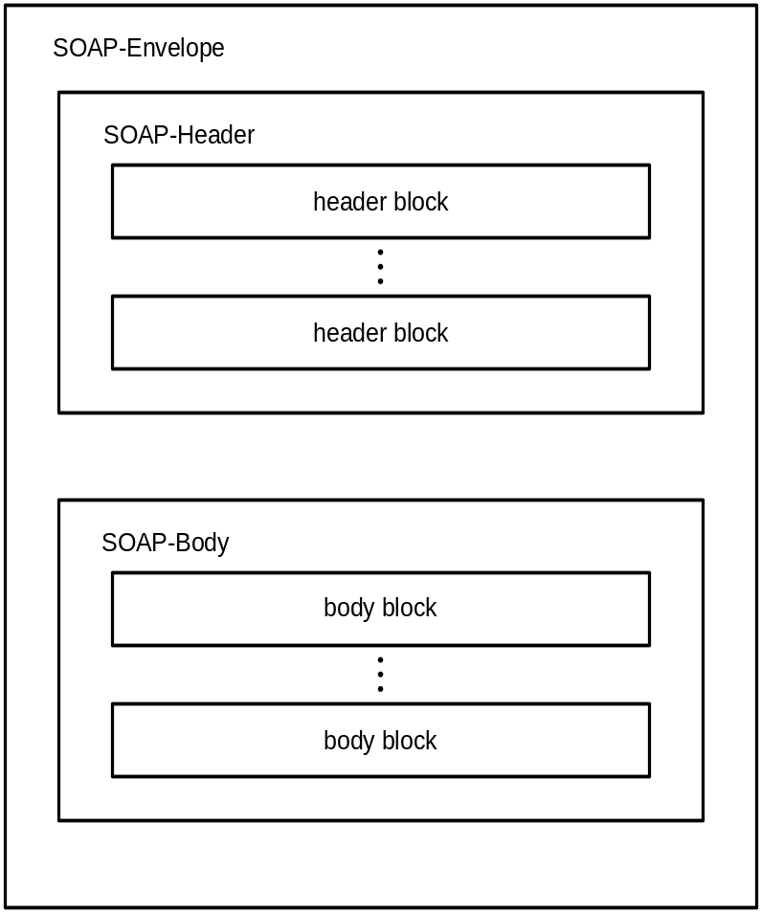
SOAP – The Messaging Protocol
<?xml version="1.0" ?>
<Envelope>
<Header>
…
</Header>
<Body>
…
</Body>
</Envelope>

Slide 7
Web Services Description Language (WSDL)
<definitions>
  <types />
  <message />
  <portType>
  <operation />
  </portType>
  <binding />
  <service>
  <port />
  </service>
</definitions>
  container for data type definitions using some type system (such as XSD)
  abstract, typed definition of the data being communicated
  abstract set of operations
  abstract description of an action supported by the service
  concrete protocol and data format specification for a particular port type
  collection of related endpoints
  single endpoint defined as a combination of a binding and a network address
source: W3C.org

Slide 8
Web Services with PHP5
Steps for creating Web Services using the SOAP extension of PHP5:
  Create XMLSchema for data types
  Write WSDL service description
  Own wrapping for Document/Literal
  Include documentation
  Build SOAP server script
  No support for additional WS-* standards (e.g. WS-Security)

Slide 9
The Vision
  Consuming Web Services already supported by tools
  Providing Web Services is still to much work
  On other platforms like Java EE or .NET:
    Extensive tool support
    Annotations
    Deployment to Application Servers
  Vision:
    Generation of Web Services for existing applications
    Configuration instead of programming
    Complete automation of the process

Slide 10
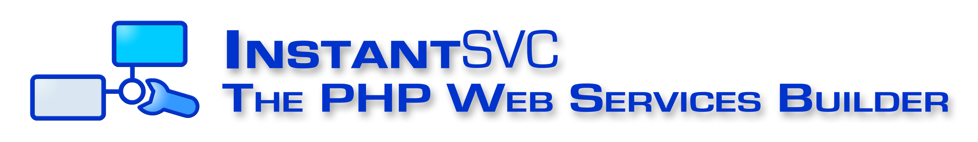
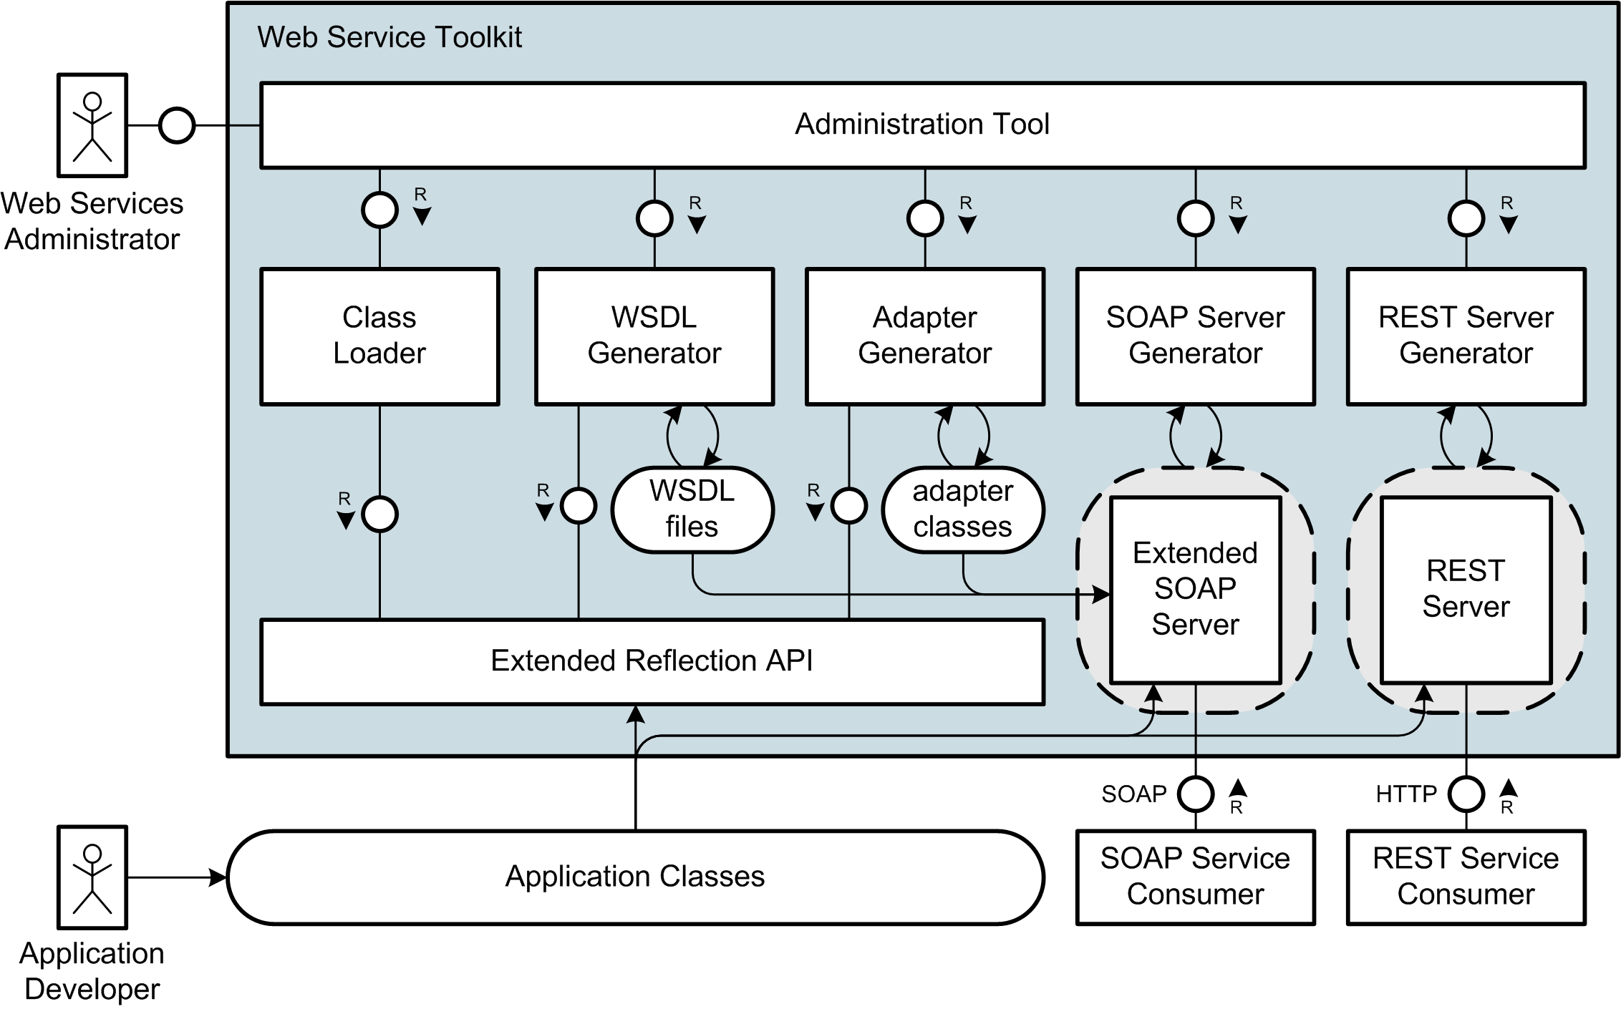
Further information and download at:
http://instantsvc.sf.net

Slide 11
In brief
  Extended Reflection API with type information
  PHP with Annotations
  WSDL-Generator (conform to WS-I Basic Profile)
  document/literal Adapter Generator
  Handler Chain Mechanism for SOAP processing
  implementation of WS-Security and the Username Token Profile
  Server for RESTful Web Services
  Administration Tool for convenient creation und management of SOAP- und REST-Services
Notes:
Die Gliederung noch überarbeiten
Einzelteile vielleicht unter Web Service Toolkit für PHP5 zusammenfassen

Slide 12
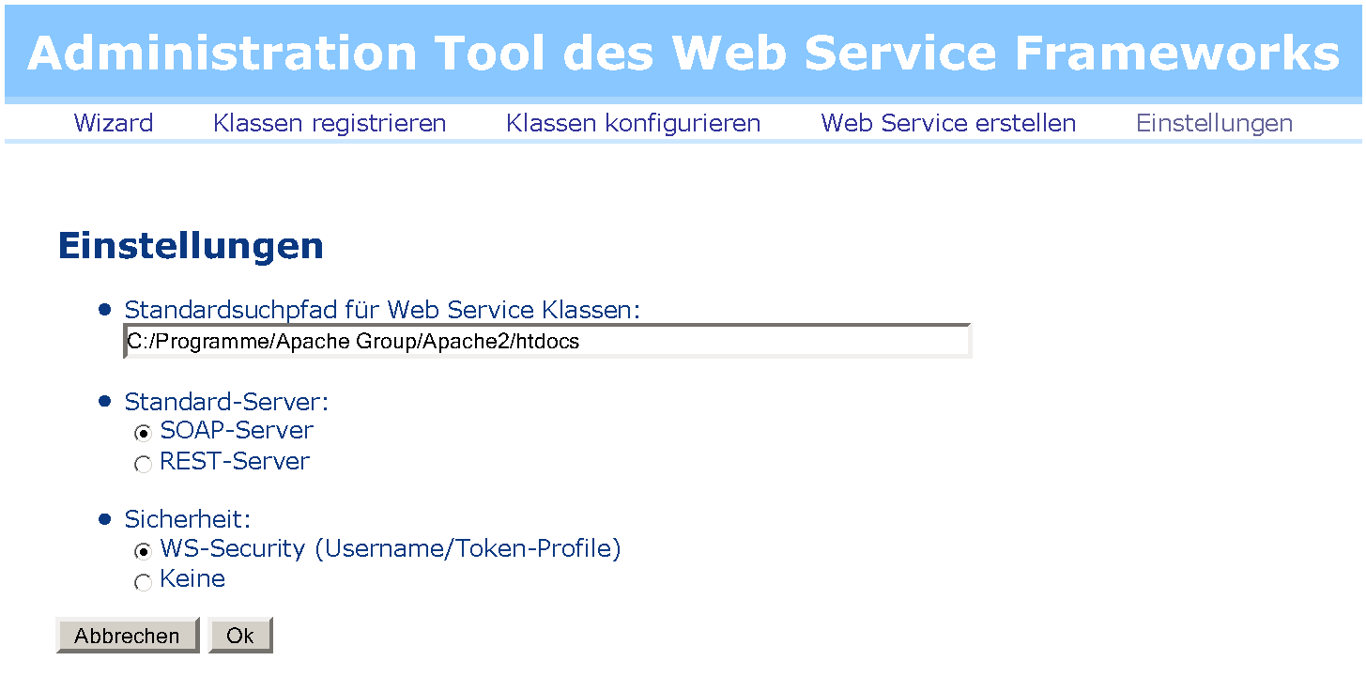
InstantSVC Adminstration Frontend

Slide 13
InstantSVC

Slide 14
Suggested Reading
White Papers
[1] Einführung in XML Web Services, October 2005
[2] Web Services Facade for PHP5 – Konzeption, January 2006
[3] Web Service Toolkit für PHP5, March 2006
download at http://instantsvc.sf.net/
Further Sources
[4] RESTful Web Services, January 2006
http://www.stefan-marr.de/artikel/restful-web-services.html
[5] SOAP Version 1.2 specification, W3C Recommendation, June 2003. http://www.w3.org/TR/soap/
[6] Web Services Description Language (WSDL) 1.1, W3C Note, March 2001. http://www.w3.org/TR/wsdl/
[7] Username Token Profile 1.0, OASIS, January 2004
http://docs.oasis-open.org/wss/2004/01/oasis-200401-wss-username-token-profile-1.0.pdf

Slide 15
Web Services Description Language (WSDL)
<definitions>
  <types /> – a container for data type definitions using some type system (such as XSD)
  <message /> – an abstract, typed definition of the data being communicated
  <portType /> – an abstract set of operations supported by one or more endpoints
  <operation /> – an abstract description of an action supported by the service
  <binding /> – a concrete protocol and data format specification for a particular port type
  <port /> – a single endpoint defined as a combination of a binding and a network address
  <service /> – a collection of related endpoints
</definitions>
source: W3C.org

Slide 16
Web Services Description Language (WSDL)
<definitions>
  <types />
  <message />
  <portType>
  <operation />
  </portType>
  <binding />
  <service>
  <port />
  </service>
</definitions>
  a container for data type definitions using some type system (such as XSD)
  an abstract, typed definition of the data being communicated
  an abstract set of operations
  an abstract description of an action supported by the service
  a concrete protocol and data format specification for a particular port type
  a collection of related endpoints
  a single endpoint defined as a combination of a binding and a network address
source: W3C.org

Slide 17
WSDL
  a container for data type definitions using some type system (such as XSD)
  an abstract, typed definition of the data being communicated
  an abstract set of operations supported by one or more endpoints
  an abstract description of an action supported by the service
  a concrete protocol and data format specification for a particular port type
  a single endpoint defined as a combination of a binding and a network address
  a collection of related endpoints

